Slide 1
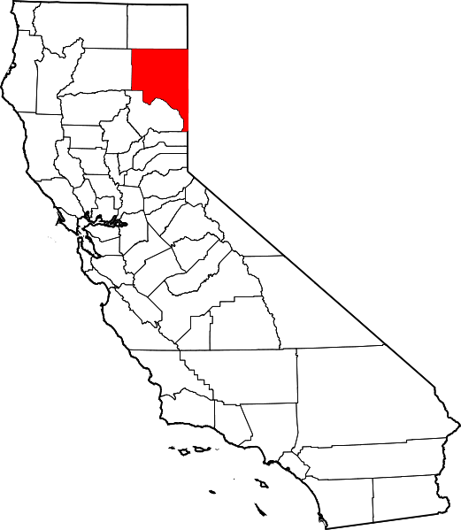

Slide 2
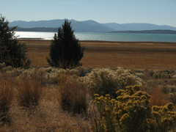

Slide 3
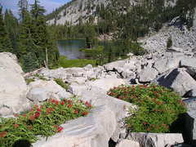

Slide 4
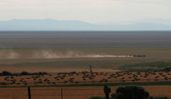

Slide 6
LASSEN REGIONAL SOLID WASTE MANAGEMENT AUTHORITY JOINT POWERS (CITY OF SUSANVILLE AND COUNTY OF LASSEN) AGENCY FORMED SEPTEMBER 1998 ABILITY TO GRANT REFUSE COLLECTION FRANCHISES ANYWHERE IN COUNTY PER CALIFORNIA PUBLIC RESOURCES CODE SECTION 40059(a)(2)

Slide 7
LASSEN WASTE SYSTEMS ACQUIRED BY WMI IN 1999 ORIGINAL FRANCHISE AGREEMENT AWARDED JULY 2001 FIVE YEAR EXTENSION EXECUTED DECEMBER 2006 CURRENT FRANCHISE AGREEMENT EXPIRES IN JANUARY 2012

Slide 8
CURRENT FRANCHISE AREA MAP IN EFFECT UNTIL JANUARY 2012 ONLY AREA 3 FRANCHISED. ALL OTHER AREAS OPEN TO COMPETITION.

Slide 9
LASSEN WASTE SYSTEMS MADE SIGNIFICANT SITE IMPROVEMENTS IN 2008 AT THEIR TRUCK FACILITY INCLUDING DRAINAGE, WASH STATION AND PARKING/MANEUVERING CONCRETE PADS

Slide 10
LASSEN WASTE SYSTEMS TRUCK FACILITY

Slide 11
AT THE DECEMBER 2009 BOARD MEETING OF LRSWMA FORMED A REFUSE COLLECTION AD HOC COMMITTEE DEVELOP DESIRED SERVICES FOR NEW EXCLUSIVE FRANCHISE AGREEMENT STARTING JANUARY 2012 ALSO DEVELOP RECOMMENDATION TO EXERCISE EITHER 5-YEAR EXTENSION OPTION WITH LASSEN WASTE SYSTEMS OR GET PROPOSALS FROM OTHER COMPANIES

Slide 12
EARLY MEETINGS OF AD HOC COMMITTEE FOCUSED ON BIG QUESTIONS SUCH AS…
1) Should the Board of Directors Allow the Existing Franchise to Expire on December 31, 2011 and Not Franchise any Solid Waste Collection Operation in Lassen County? NO! – Cannot Direct Waste to Bass Hill Landfill and Loss of Franchise Fee. 2) Should the Franchise Be Allowed to Expire and the LRSWMA Become a Refuse Collector? NO! – Startup Costs are High and Government Operation of Refuse/Recyclables Collection is Problematic. 3) Should Refuse Collection Services be Mandatory for Residential and Commercial Customers in Susanville and Lassen County Starting January 1, 2012 or sooner? NO! – Little Political Will. Trip to Landfill Social Event for Many Residents. 4) Should the Franchise Area be Extended to the Herlong and Westwood Areas Starting January 1, 2012 or sooner? YES! – Improves Economy of Scale. Increases Franchise Fee. Improves Services in Rural Areas.

Slide 13
ENLARGED FRANCHISE MAP INCLUDED HERLONG AND WESTWOOD AREAS ALSO ESTABLISH “PRIMARY” AND “SECONDARY” FRANCHISE AREAS

Slide 14
OTHER ISSUES RECOMMENDED BY AD HOC COMMITTEE AND ACCEPTED BY LRSWMA BOARD OF DIRECTORS
TERM OF THE NEW FRANCHISE AGREEMENT: 7 YEARS INITIAL PLUS 5 YEAR OPTION
INCREASE THE FRANCHISE FEE FROM 5% OF GROSS REVENUES TO 8%
ANNUAL FEE INCREASES OF 90% OF WESTERN REGION CPI PLUS 10% OF WESTERN REGION FUEL INDEX
ALLOW COLLECTION STARTING TIME 5 AM IN NON-RESIDENTIAL AREAS AND ALLOW SATURDAY COLLECTION OF COMMERCIAL REFUSE AND RECYCLABLE MATERIALS
ALLOW COMPANIES TO PROPOSE ON CURBSIDE COLLECTION OF GREEN WASTES, UNIVERSAL WASTES, ELECTRONIC WASTES AND BULKY ITEMS
ALLOW COMPANIES TO PROPOSE FEES FOR COLLECTION OF COMMERCIAL RECYCLABLES
NO MANDATORY COMMERCIAL RECYCLING REQUIREMENT
ISSUE A REQUEST FOR PROPOSAL FOR REFUSE COLLECTION SERVICES

Slide 15
REQUEST FOR PROPOSAL ISSUED OCTOBER 6, 2010
REQUEST FOR PROPOSAL INCLUDED THE FOLLOWING:
STATED DESIRE TO OBTAIN AS MANY RESIDENTIAL AND COMMERCIAL CUSTOMERS AS POSSIBLE IN THE REFUSE/RECYCLABLE MATERIAL COLLECTION SYSTEM
COLLECT RESIDENTIAL TRASH IN 32, 64 AND 96 GALLON WHEELED CARTS
NO CHARGE RESIDENTIAL COLLECTION OF RECYCLABLE MATERIALS
DELIVER ALL COLLECTED REFUSE TO BASS HILL LANDFILL
DEMOGRAPHICS OF SUSANVILLE AND LASSEN COUNTY, INCLUDING CURRENT CUSTOMER BASE SERVICE LEVELS AND ANNUAL TONNAGES REFUSE AND RECYCLABLE MATERIALS
$250,000 PERFORMANCE BOND
NO CALL CENTER!

Slide 16
MANDATORY PRE-PROPOSAL MEETING OCTOBER 19, 2010
CONTACTED ALL NATIONAL AND MANY REGIONAL WASTE COMPANIES
EIGHT COMPANIES ATTENDED THE MANDATORY MEETING IN SUSANVILLE:
ATLAS DISPOSAL (SACRAMENTO)
C&S WASTE SOLUTIONS (UKIAH AND PAHRUMP, NV)
INTERMOUNTAIN DISPOSAL COMPANY (PORTOLA AND PLUMAS COUNTY)
NORTHERN RECYCLING AND WASTE SYSTEMS (NAPA AND PARADISE)
RECOLOGY (FORMERLY NORCAL)
WILLITS SOLID WASTE
WASTE CONNECTIONS
WASTE MANAGEMENT (LASSEN WASTE SYSTEMS)

Slide 17
PROPOSALS DUE DECEMBER 15, 2010 AT 4 PM
SIX COMPANIES SUBMITTED PROPOSALS FOR REFUSE COLLECTION SERVICES:
C&S WASTE SOLUTIONS (UKIAH AND PAHRUMP, NV)
INTERMOUNTAIN DISPOSAL COMPANY (PORTOLA AND PLUMAS COUNTY)
NORTHERN RECYCLING AND WASTE SYSTEMS (NAPA AND PARADISE)
WILLITS SOLID WASTE
WASTE CONNECTIONS
WASTE MANAGEMENT (LASSEN WASTE SYSTEMS)

Slide 18
INITIAL EVALUATION OF PROPOSALS
NO SCORING OF PROPOSALS. USED OBJECTIVE AND SUBJECTIVE CRITERIA.
INITIAL RANKING OF COMPANIES BASED ON COST OF SERVICES FOR RESIDENTIAL AND COMMERCIAL WASTE COLLECTION
THE CURRENT COST OF SERVICES (USING THE MOST COMMON NUMBER OF CUSTOMERS AND SERVICE LEVELS) IS $2,834,276 PER YEAR
1 LASSEN WASTE SYSTEMS $2,571,933 -9.26%
2 SOLID WASTE OF WILLITS $2,614,249 -7.76%
3 C&S WASTE SOLUTIONS $2,772,452 -2.18%
4 WASTE CONNECTIONS $2,890,065 +1.97%
5 INTERMOUNTAIN DISPOSAL $2,979,877 +5.14%
6 NORTHERN WASTE SERVICES $3,182,995 +12.30%
ELIMINATED INTERMOUNTAIN DISPOSAL AND NORTHERN WASTE SERVICE AT JAN BOD MEETING

Slide 19
FURTHER EVALUATION OF REMAINING FOUR COMPANIES
CONDUCTED SITE VISITS OF EACH OF THE PROPOSING COMPANY’S FACILITIES
ALLOWED EACH OF THE COMPANIES TO MAKE PUBLIC PRESENTATIONS ON THE MERITS OF THEIR PROPOSALS AT A SPECIAL BOARD OF DIRECTORS MEETING
DEVELOPED SUMMARY OF SERVICES IN MATRIX FORMAT TO ALLOW FOR EASIER COMPARSION OF EACH OF THE COMPANIES PROPOSED SERVICES

Slide 20
C&S WASTE SOLUTIONS PROPOSED SERVICES
LOWER REFUSE COLLECTION FEES THAN CURRENTLY CHARGED
NO FEE COMMERCIAL RECYCLING
NO FEE CURBSIDE COLLECTION OF ELECTRONIC WASTE (UP TO 5 ITEMS/YEAR), WASTE OIL AND FILTERS, BULKY ITEMS (UP TO 2 ITEMS PER YEAR) AND CHRISTMAS TREES.
SPLIT BODY AUTOMATED RESIDENTIAL COLLECTION TRUCKS
CURBSIDE COLLECTION GREEN WASTES IN THE PRIMARY AREA, 96 GALLON CONTAINER, $4.75 PER MONTH
GREEN WASTE GRINDING/REMOVAL AT BASS HILL LANDFILL, NO CHARGE TO LRSWMA
ASSIST LRSWMA WITH DIVERSION OF C&D AT BASS HILL LANDFILL
NO CHARGE DEBRIS BOXES FOR COMMUNITY CLEANUP EVENTS
DEMONSTRATED INVOLVEMENT WITH COMMUNITY AT OTHER JURISDICTIONS THEY SERVE

Slide 21
LASSEN WASTE SYSTEMS (WMI) PROPOSED SERVICES
LOWEST PROPOSED REFUSE COLLECTION FEES (APPROXIMATELY 12% LOWER FEES THAN CURRENTLY CHARGED WHEN INCREASE IN FRANCHISE FEE IS CONSIDERED)
FEES FOR COMMERCIAL RECYCLING BINS
CURBSIDE COLLECTION OF E-WASTE, $20 PER ITEM
NO OTHER NEW SERVICES THAN WHAT’S CURRENTLY OFFERED

Slide 22
WILLITS SOLID WASTE PROPOSED SERVICES
LOWER REFUSE COLLECTION FEES THAN CURRENTLY CHARGED
20 GALLON REFUSE CONTAINERS AT LOW COST ($12.86 /MONTH PRIMARY AREA)
FEES FOR COMMERCIAL RECYCLING BINS
NO FEE CURBSIDE COLLECTION OF WASTE OIL AND FILTERS
CURBSIDE COLLECTION OF BULKY ITEMS, $30 EACH
CURBSIDE COLLECTION GREEN WASTES IN THE PRIMARY AREA, 96 GALLON CONTAINER, $35.00 PER MONTH
NO CHARGE DEBRIS BOXES FOR COMMUNITY CLEANUP EVENTS

Slide 23
WASTE CONNECTIONS PROPOSED SERVICES
SLIGHTY HIGHER REFUSE COLLECTION FEES THAN CURRENTLY CHARGED
NO FEE COMMERCIAL RECYCLING BINS
NEW REFUSE COLLECTION TRUCKS
NO FEE CURBSIDE COLLECTION OF WASTE OIL AND FILTERS
CURBSIDE COLLECTION OF BULKY ITEM, ONE FREE PER YEAR
CURBSIDE COLLECTION GREEN WASTES IN THE PRIMARY AREA IN BAGS, $3.00 PER BAG
NO CHARGE DEBRIS BOXES FOR COMMUNITY CLEANUP EVENTS
10% DISCOUNT FOR SENIORS SUBSCRIBING TO 32 GALLON CART

Slide 24
FRANCHISE AWARDED TO C&S WASTE SOLUTIONS ON FEBRUARY 22, 2011 BY THE LRSWMA BOARD OF DIRECTOR
SMALLER COMPANY, OWNERS IN REFUSE BUSINESS FOR MANY YEARS

Slide 25
C&S WASTE SOLUTIONS
DEMONSTRATED WASTE DIVERSION
GREEN WASTE GRINDING AT BASS HILL LF

Slide 26
C&S WASTE SOLUTIONS
CUSTOMER SERVICES
COMMUNITY INVOLVEMENT

